Slide 1
Adaptation Financing through NAPs and NDCs: Mexico Experience
Thursday, July 6, 2023, 9:00AM-10:30AM, EDT
Alejandro Camacho, Director of Sustainable Financing, Ministry of Finance and Public Credit

Slide 2
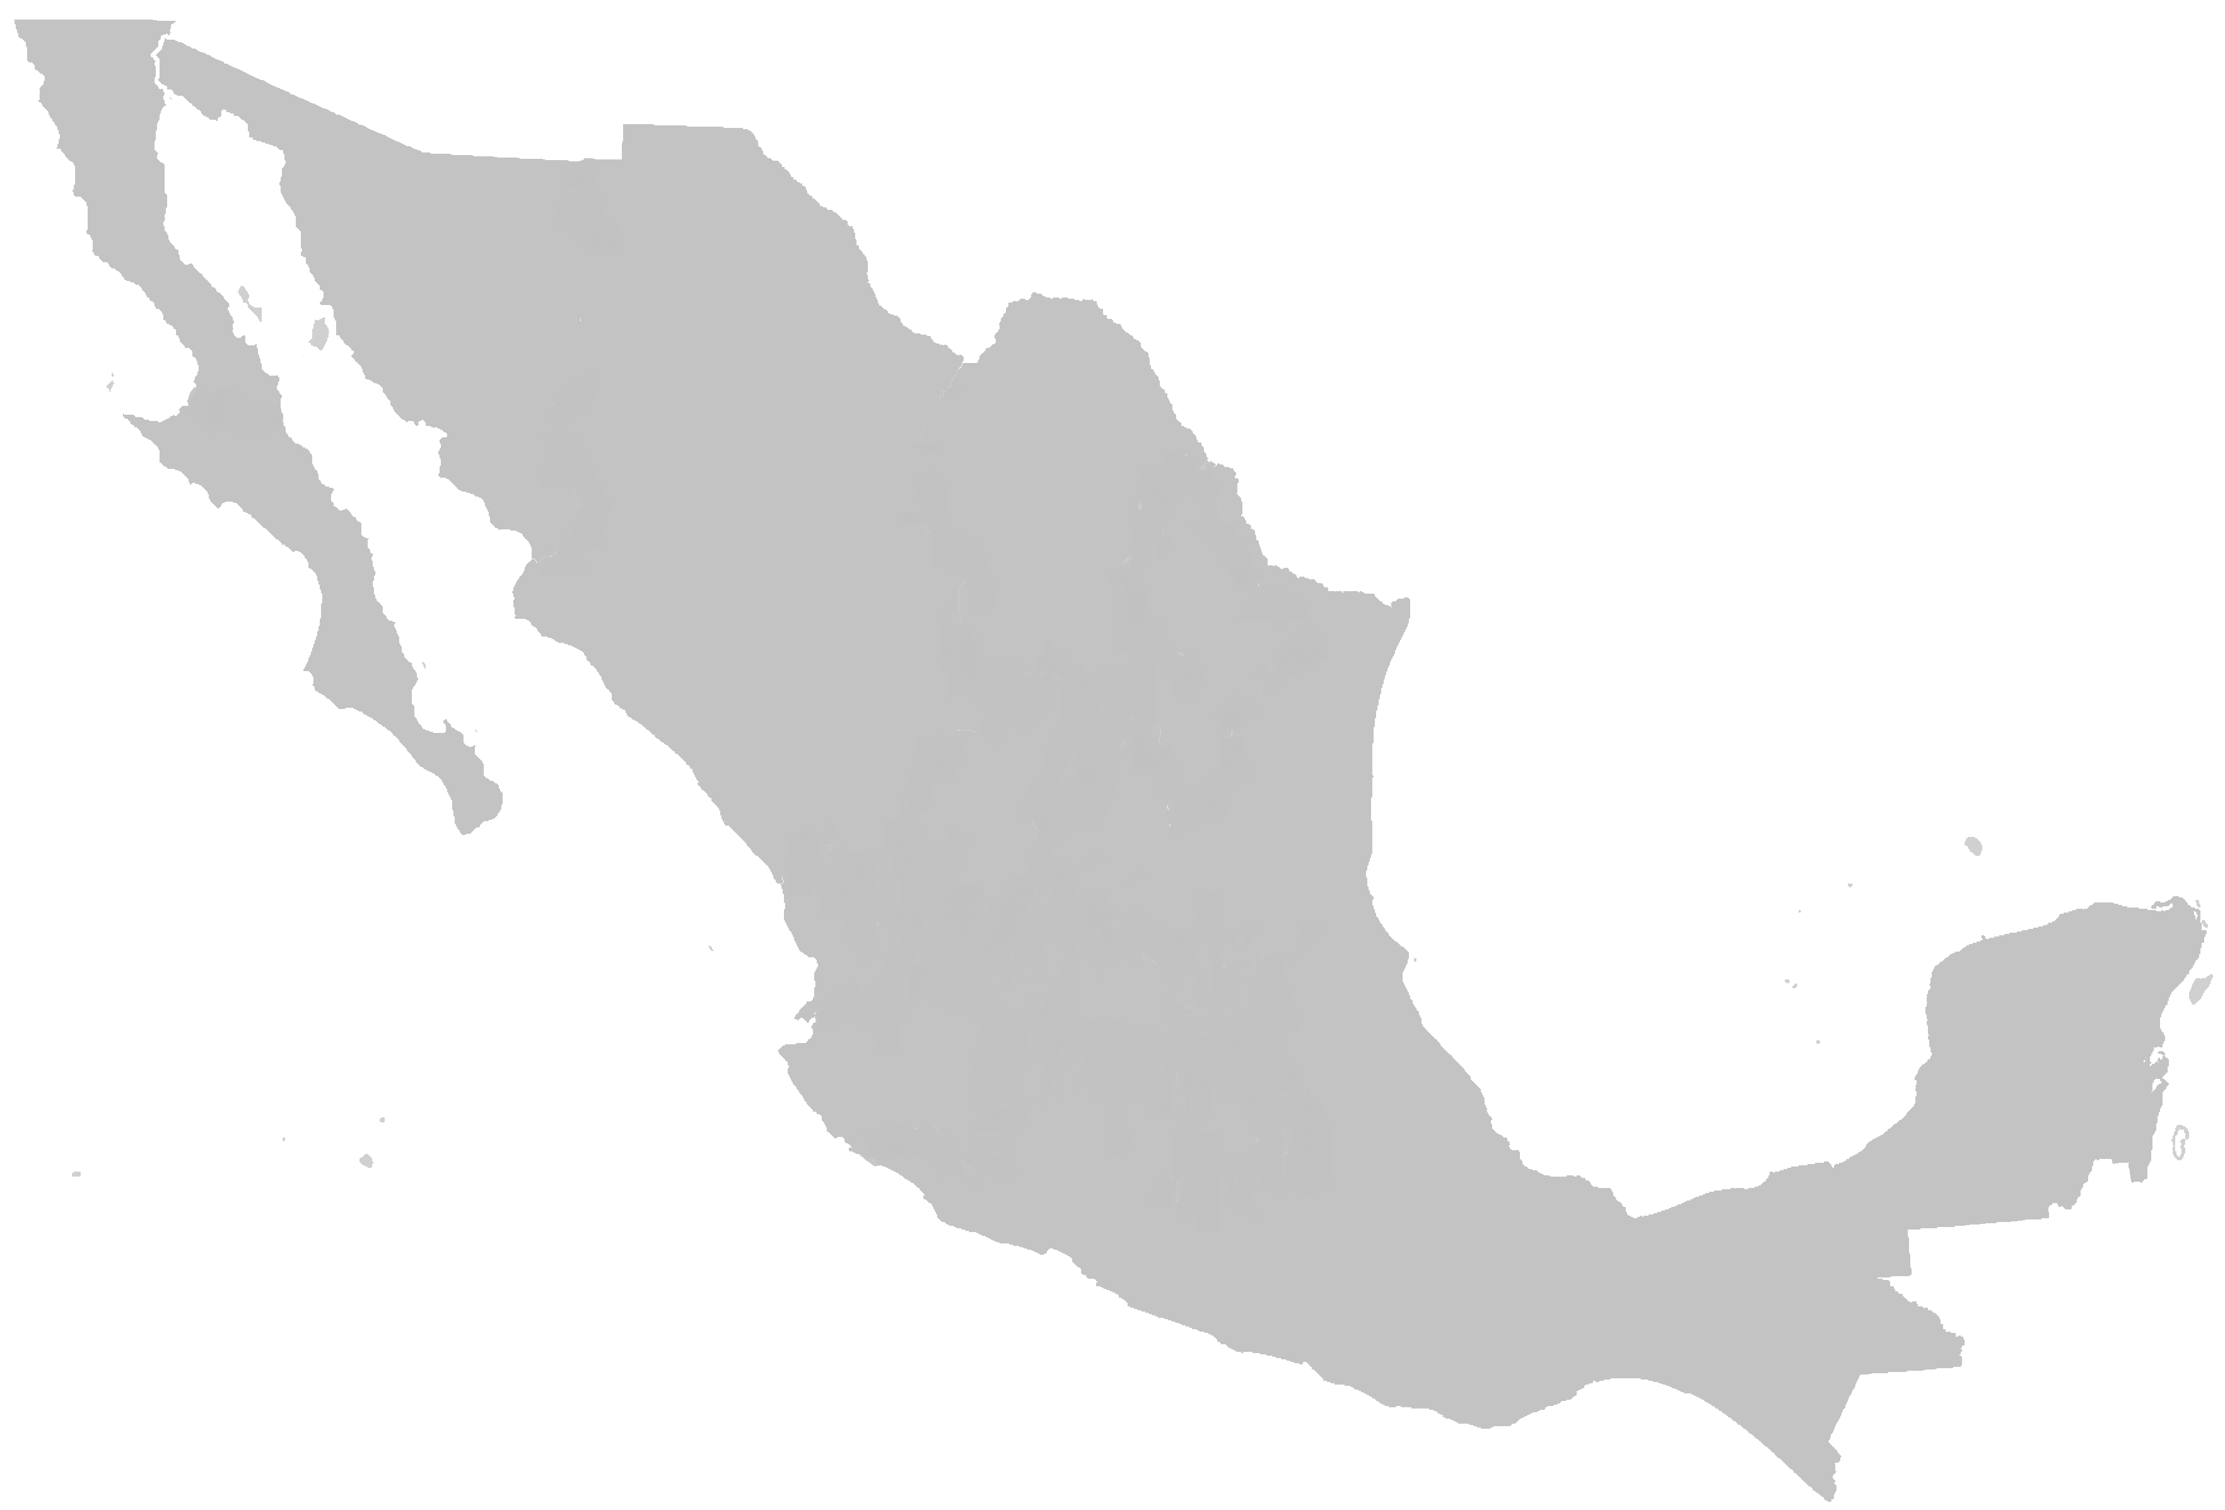



The Ministry of Finance is working on developing policy instruments to mobilize financing for Adaptation
National level
Policy Instruments from the Ministry of Finance
The General Law of Climate Change (2012)
The Inter-Ministerial Commission on Climate Change (Adaptation Working Group)
The Paris Agreement (NDC: mitigation and adaptation)​
Strategy for the Mobilization of Finance
Public Budget: Cross-cutting annex on climate change (adaptation mitigation and adaptation)
Sustainable Taxonomy
Climate vulnerabilities
Financing
Socioeconomic gap

Slide 3









The Sustainable Taxonomy is unique at a global level and the first one to incorporate social objectives
ECONOMIC SECTORS
Mitigation
Gender equality
1
Agriculture and forestry
3
Energy and water
Manufacture
Adaptation
Transport
2
Cross-cutting across all sectors of the economy
Construction
Waste management
Catalogue 124 activities
Gender Equality Index

Slide 4
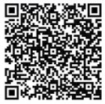
Thank you
Taxonomia_sost@hacienda.gob.mx
https://www.gob.mx/shcp/documentos/taxonomia-sostenible-de-mexico?state=published

