Slide 1


Adaptation Planning and Financing through NAPs and NDCs
Rohini Kohli (UNDP) and Jessica Troni (UNEP)
6th of July 2023
Source: UNDP Pakistan.

Slide 2




Agenda
Adaptation gaps and barriers
Adaptation planning and financing through NAPs and NDCs
Financing nature-based solutions for adaptation
Picture: Add source
Key takeaways

Slide 3
Why adaptation?
Climate change can reverse hard-won development gains, worsen inequalities and trigger displacement and conflict. It could drive an additional 122 million people into poverty by 2030 (IPCC 2022).
“The adverse impact of climate change will cost Egypt more than 6 per cent of its GDP annually, and sea-level rise will affect 25 per cent of its population and 90 per cent of its agricultural land” (Osama Mahmoud Abdel Khalek Mahmoud, Permanent Representative of Egypt to the United Nations)

Slide 4
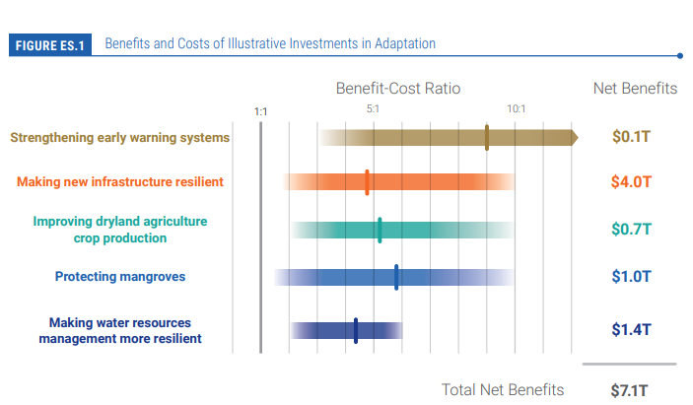
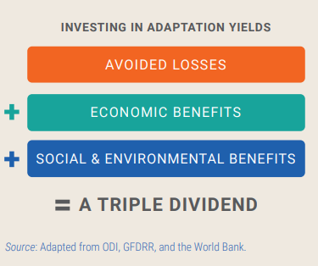
Why adaptation for Ministries of Finance?
Source: Global Commission on Adaptation 2019.

Slide 5

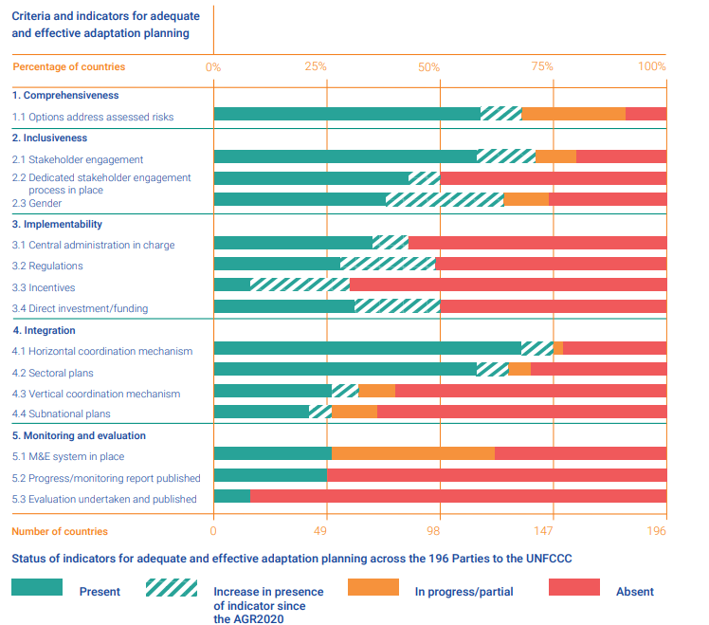
Adaptation Gaps
Too little, too slow
Key Adaptation Gaps
Current adaptation practice falls woefully short of what is required, in both nature and extent.
Many initiatives prioritize immediate and near-term climate risk reduction which reduces the opportunity for transformational adaptation
About 25% of the countries have a monitoring and evaluation framework in place
Data availability on the effectiveness and adequacy of adaptation is poor, especially for higher warming levels.
Source: UNEP 2021

Slide 6
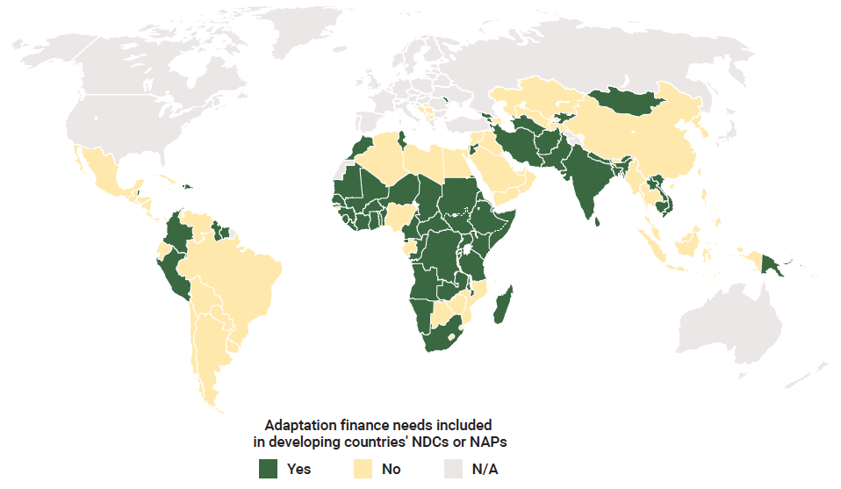
The adaptation finance gap in developing countries is likely 5-10 times greater than current international finance flows and continues to widen
Information on adaptation finance needs
International adaptation finance reached US$29 billion in 2020
Estimated annual adaptation costs are US$160-340 billion by 2030 and US$315-565 billion by 2050
At current rates the US$100 billion pledged to developing countries will only be reached in 2025
Doubling of 2019 finance flows by 2025, as the Glasgow Climate Pact urged, requires strong acceleration
NDCs: Nationally Determined Contributions
NAPs: National Adaptation Plans
Source: UNEP 2022
Notes:
Source: AGR 2022

Slide 7
OUR EXISTENCE
Barriers to Adaptation
TECHNICAL CAPACITY CONSTRAINTS
  Limited institutional capacity and expertise among policymakers and local authorities to mainstream adaptation into policies, plans and investments
  Limited technical experience of professionals
INSUFFICIENT PUBLIC AND POLITICAL SUPPORT
GOVERNANCE CHALLENGES
  ﻿Unclear institutional arrangements and decision-making procedures
  Lack of cross-sectoral and inter-institutional collaboration
  Challenges establishing effective multi-stakeholder partnerships
  Lack of political leadership
  Limited public support due to lack of awareness, cultural constraints and entrenched preferences
POLICY AND REGULATORY CHALLENGES
FINANCE CHALLENGES
  Lack of supportive policies, strategies, regulations or inadequate enforcement of regulations
  Limited mainstreaming across sectors
  Lack of coherence across national and local policies and regulations
  ﻿Insufficient availability of public and private finance
  Insufficient financial incentives and business models
  Existing financial instruments and policies (i.e. perverse subsidies, incentives and tax breaks) that undermine adaptation efforts
Notes:
Source: Harnessing nature for scaling up EbA, UNEP, 2022

Slide 8
Adaptation Planning through NDCs and NAPs
NDCs
NAPs
Mitigation and Adaptation - vision and objectives
175 countries have submitted new or updated NDCs. 145 NDCs have adaptation components
Short to medium term (5-10 years), update every 5 years
1/4 of the members of the Coalition are actively involved in all stages of the NDC development and implementation process
Adaptation – priorities and action plan
45 countries submitted to the UNFCCC
Medium to long term (5-10 years)
Mainly led by the Ministries of Environment, limited engagement of Ministries of Finance
170 countries include adaptation in their policies and planning processes

Slide 9
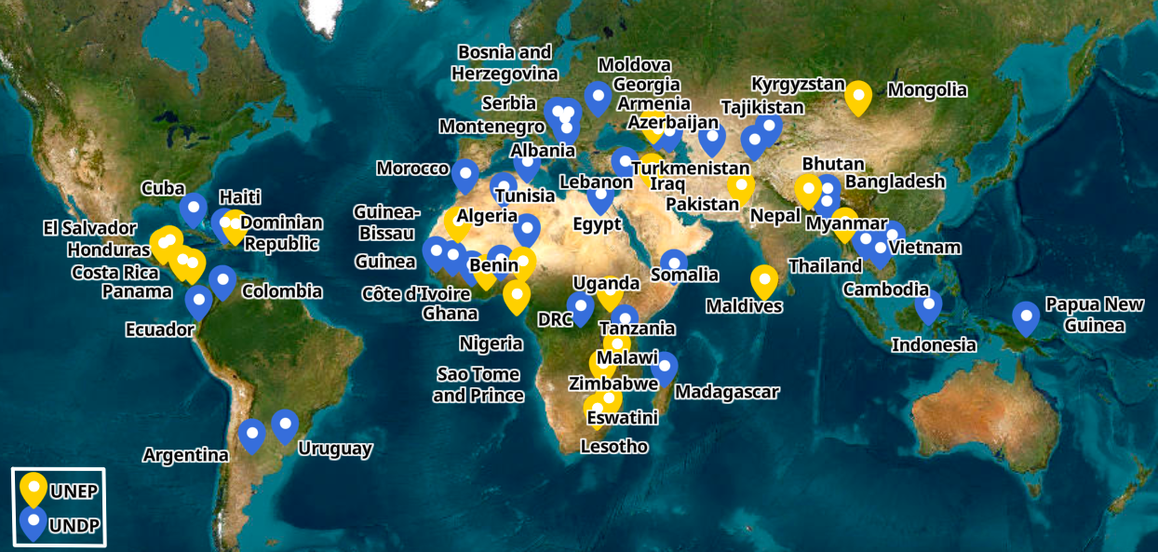

UNDP and UNEP support to Adaptation Planning
Notes:
UNDP 35+12 (SCALA)
UNEP 21 countries

Slide 10
Mainstreaming in plans and budgets
Quantifying the cost of adaptation options
Strengthening adaptation governance
Nature based solutions
Adaptation pipelines and projects
Financing strategies, investment plans
Enhancing the evidence, metrics and capacity
Adaptation Planning and Financing through NAPs and NDCs

Slide 11
Mainstreaming in plans and budgets
Quantifying the cost of adaptation options
Strengthening adaptation governance
Nature based solutions
Adaptation pipelines and projects
Financing strategies, investment plans
Enhancing the evidence, metrics and capacity
Adaptation Planning and Financing through NAPs and NDCs

Slide 12
NAP financing strategies and NDC investment plans
Bangladesh prepared a comprehensive NAP including investment plan and portfolio as well as a sector wide NDC investment strategy, assessing costs and proposing various investment opportunities and possible funding sources for NDC actions.
Following the adoption of its Climate Fiscal Frameworks, Chile developed its Climate Change Finance Strategy.
In Bosnia and Herzegovina, four municipalities have developed and adopted Local climate adaptation finance strategies and investment plans, developed project concepts for submission to GCF and other funds.
Uruguay has developed a financing strategy for the NAP Cities, incl. possible finance instruments from domestic and international sources and opportunities for public-private partnerships.

Slide 13
Mainstreaming in plans and budgets
Quantifying the cost of adaptation options
Strengthening adaptation governance
Nature based solutions
Adaptation pipelines and projects
Financing strategies, investment plans
Enhancing the evidence, metrics and capacity
Adaptation Planning and Financing through NAPs and NDCs

Slide 14
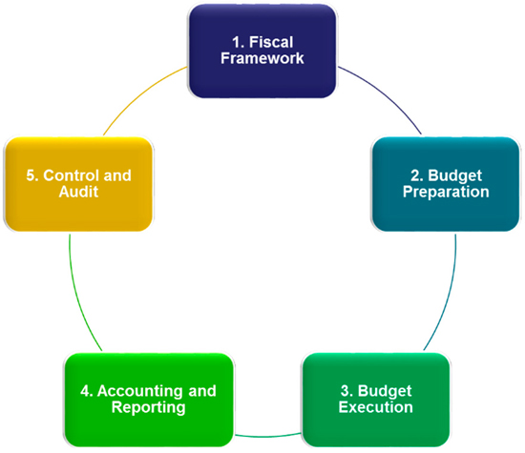
Mainstreaming climate change across the budget cycle
Determining climate fiscal policies and financing; including climate change in strategic planning
Climate Public Exp & Institutional Reviews (CPEIRs)
Climate Change Budget Integration Index (CCBII)
Climate Change Financing Frameworks (CCFFs)
Institutionalizing role of Parliament and other accountability actors
Developing climate responsive medium-term and annual budgets; estimating costs and benefits of climate investments
Making the legal and regulatory environment climate responsive
Climate Performance Audits (CPAs)
Citizens’ Climate Budget (CB)
Medium Term Budget /Exp Framework (MTBF/MTEF)
Climate Cost Benefit Analysis (CCBA)
Using CBT to generating climate expenditure reports
Tracking climate relevant allocations expenditure through tagging/coding
Climate Expenditure Reports
Climate Budget Tagging (CBT)

Slide 15
Strengthening and Enhancing Adaptation Finance
Estimating and roadmap for adaptation finance through fiscal frameworks and financing strategies
Azerbaijan, Bangladesh, Chile, Indonesia (under review)
Climate integrated budgeting-systemic and process reforms. MTEF, budget call circular – prioritizing climate finance for adaptation
Bangladesh (MTEF), Mexico (Developing sustainability indicators)
Planning process – informed allocations for climate change adaptation investments
Cambodia (system reforms), Nepal, Pakistan
Risk screening and climate cost benefit analysis of adaptation projects
Fiji, Tonga (Risk screening for development investments) , Thailand)
Climate budget tagging/expenditure review of adaptation allocations and expenditure
Armenia, Eswatini, Indonesia, Namibia, Nepal, Rwanda
Strengthening role of accountability actors on adaptation finance
Cambodia, Nepal, Uzbekistan
Private sector financing
Columbia, Indonesia, Uzbekistan

Slide 16
Mainstreaming in plans and budgets
Quantifying the cost of adaptation options
Strengthening adaptation governance
Nature based solutions
Adaptation pipelines and projects
Financing strategies, investment plans
Enhancing the evidence, metrics and capacity
Adaptation Planning and Financing through NAPs and NDCs
Notes:
Enhancing the evidence base: climate risk and vulnerability assessments, appraisal of adaptation options. E.g. Serbia conducted multi-hazard comprehensive risk and vulnerability assessments on the nexus between agriculture & water management as well as infrastructure, energy, forestry, health and biodiversity, and formulated concrete adaptation measures in these sectors. These assessments will continue to be available for policy and planning purposes through a web-based platform.
Strengthening adaptation governance: strengthening of coordination mechanisms for CCA, improve regulatory, institutional and legal environment for adaptation, with activities such as Formation of inter-ministerial/inter-department committees, Development/amendment of laws and decrees that assign responsibility and accountabilities for adaptation, Risk informing plans and budget systems, Mainstreaming adaptation in sub-national and sectoral plans and Fostering locally led action and greater inclusion. E.g. In Benin, Congo DR and Cote d'Ivoire, support was provided to drafting the National Climate Change Law. In Bosnia and Herzegovina, the regulatory framework to support climate change adaptation was reviewed, and the Law on Environment was amended.
Developing enabling policy and legal environment for gender responsive adaptation planning
Adaptation capacity and knowledge: Climate information and knowledge platforms in local languages, global NAP resources library (from NAP GSP), university partnerships incl. development curriculum, and trainings on various CCA relevant areas
Mainstreaming into National, Sectoral and Local Plans and Budgets: sensitization of key planning/budgeting stakeholders, budget integration, formulation of plans and strategies, vertical integration including urban resilience, gender mainstreaming. E.g. In Madagascar and Niger, climate public expenditure and institutional reviews were conducted to assess current expenditures and made recommendations to increase public investments on climate change. In Liberia, adaptation was integrated into sectoral policies for agriculture, fisheries, forestry and coastal zones. In PNG, sectoral guidelines for planning of adaptation strategies was developed
Adaptation metrics: strengthen national and sectoral level M&E, incl. development of gender sensitive indicators. E.g. In Bosnia and Herzegovina, standard operational procedures (SOPs) for institutional cooperation on climate data exchange and the corresponding M&E framework have been developed
Financing strategies: incl. quantifying the cost of adaptation options, pipeline of projects, identify finance sources and mechanisms
Partnerships: policy makers at the national, local and sectorial levels, research entities, universities, private sector etc.
NAP formulation: gender responsive, ensuring the participation of all stakeholders, incl. the most vulnerable
Plus, systems transformation and gender/social inclusion

Slide 17
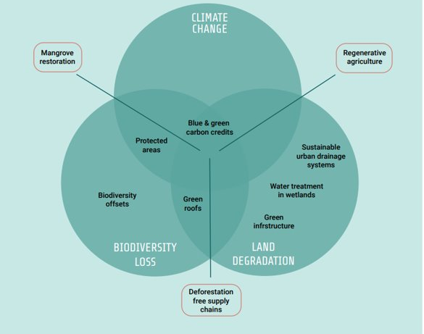
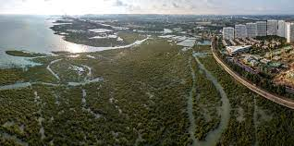
Investing in Nature-based Solutions (NbS)
NbS are opportunities to simultaneously tackle climate change, biodiversity loss and land degradation

Slide 18
Why invest in NbS/ EbA?
1. NbS are essential tools and can cost effectively deliver on climate mitigation and adaptation, biodiversity protection and land restoration, often simultaneously. Yet they are severely underfinanced.
3. Much of the NbS finance gap ($230bn) must be filled by the private sector, both businesses and the financial sector, given government debt and fiscal constraints.
4. Reform and repurposing of environmentally harmful expenditures is urgent – at $500bn to $1 trillion each year, they are 3-7 times greater than investment in nature and undermine efforts to conserve and sustainably manage biodiversity.
2. Annual current finance flows to NbS must urgently double by 2025 if we are to halt biodiversity loss, limit climate change to 1.5C and achieve land degradation neutrality by 2030.
Source: State of Finance for Nature (2022)

Slide 19
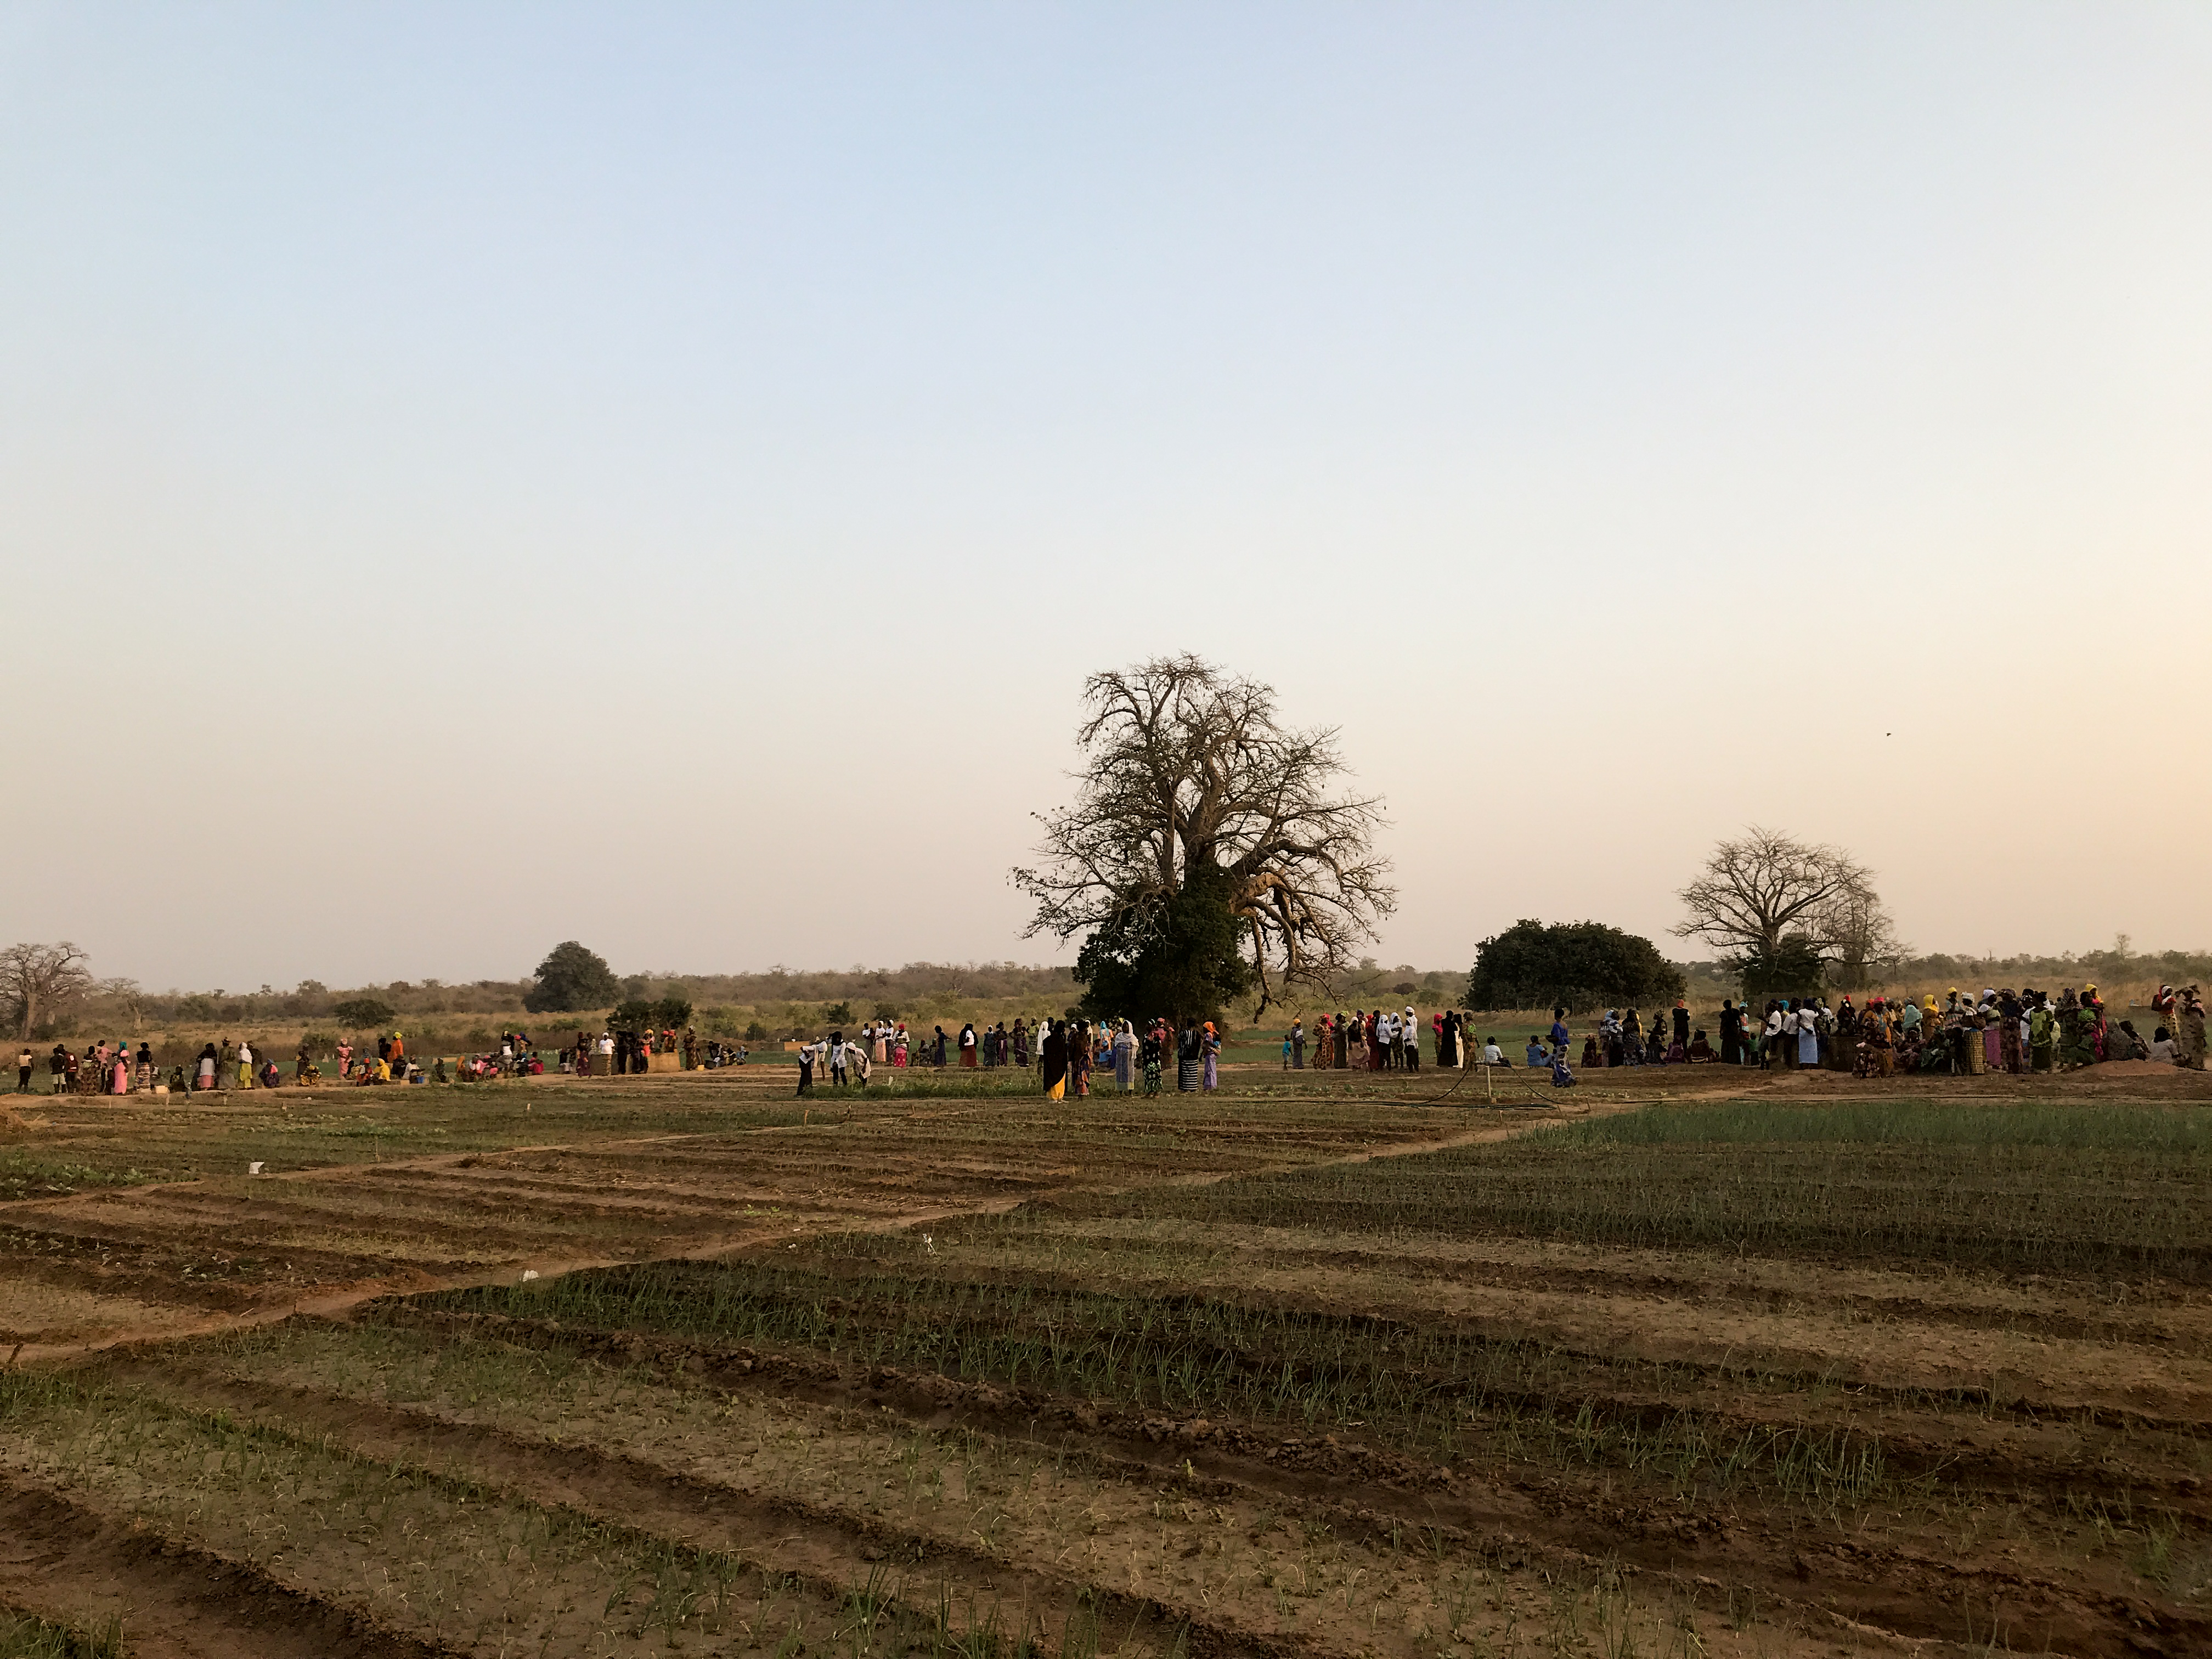
Mainstreaming Ecosystem-based Adaptation (EbA) into domestic budgets in the Gambia
4 sectoral policies (transhumance, migration, agriculture, energy) to integrate adaptation actions into their annual plans with explicit budget and monitoring structures
MoF's guidelines include EbA and sectoral EbA interventions
EbA integrated in the new National Development Plan
Budget call circular integrates EbA
Extending budget spending on EbA

Slide 20
Our take-aways from NAP and NDC implementation
Ministries of Finance can play a key role in all stages of the NAPs and NDCs.
Ministries of Finance can play a crucial role in costing adaptation options, developing financing strategies and in ensuring coherence across climate resilient investment programs more broadly.
Ongoing efforts in developing climate fiscal frameworks and efforts to enhance adaptation investment can be further integrated with NDC and NAP priorities through improved institutional coordination.
Tracking adaptation finance flows to monitor and evaluate adaptation effectiveness is an important part of national adaptation M&E systems.
Financing nature-based solutions for adaptation provides multiple benefits. Ministries of Finance can play a key role in reforming expenditures harmful to the environment and help mainstream nature-based solutions to national planning and budgeting processes.
Ministries of Finance can enhance the enabling environment for private sector to engage and invest in adaptation.

Slide 21
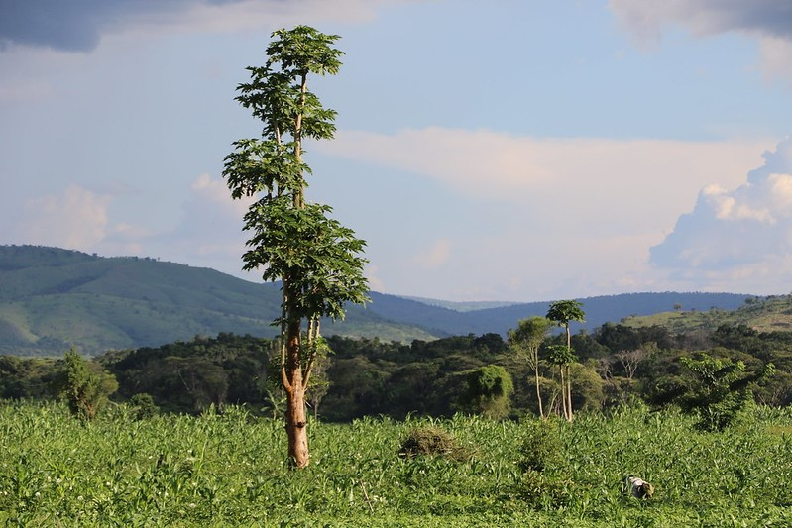
Thank you
For further information, please contact:
Rohini.Kohli@undp.org
Jessica.Troni@un.org

Slide 22
OUR EXISTENCE
Barriers to Ecosystem based Adaptation (EbA)
TECHNICAL CAPACITY CONSTRAINTS
  Limited institutional capacity and expertise among policymakers and local authorities to mainstream EbA into policies, plans and investments
  Limited technical experience of professionals in EbA initiatives
INSUFFICIENT PUBLIC AND POLITICAL SUPPORT
GOVERNANCE CHALLENGES
  ﻿Unclear institutional arrangements and decision-making procedures
  Lack of cross-sectoral and inter-institutional collaboration
  Challenges establishing effective multi-stakeholder partnerships for EbA
  Lack of political leadership and support for EbA
  Limited public support for EbA, due to lack of awareness, cultural constraints and entrenched preferences
POLICY AND REGULATORY CHALLENGES
FINANCE CHALLENGES
  Unsupportive policies and strategies
  Lack of supportive regulations or inadequate enforcement of regulations
  Difficulty of mainstreaming EbA across sectors
  Lack of coherence across national and local policies and regulations
  ﻿Insufficient availability of public and private finance
  Lack of financial incentives and business models for EbA
  Existing financial instruments and policies (i.e. perverse subsidies, incentives and tax breaks) often undermine EbA
Notes:
Source: Harnessing nature for scaling up EbA, UNEP, 2022

Slide 23
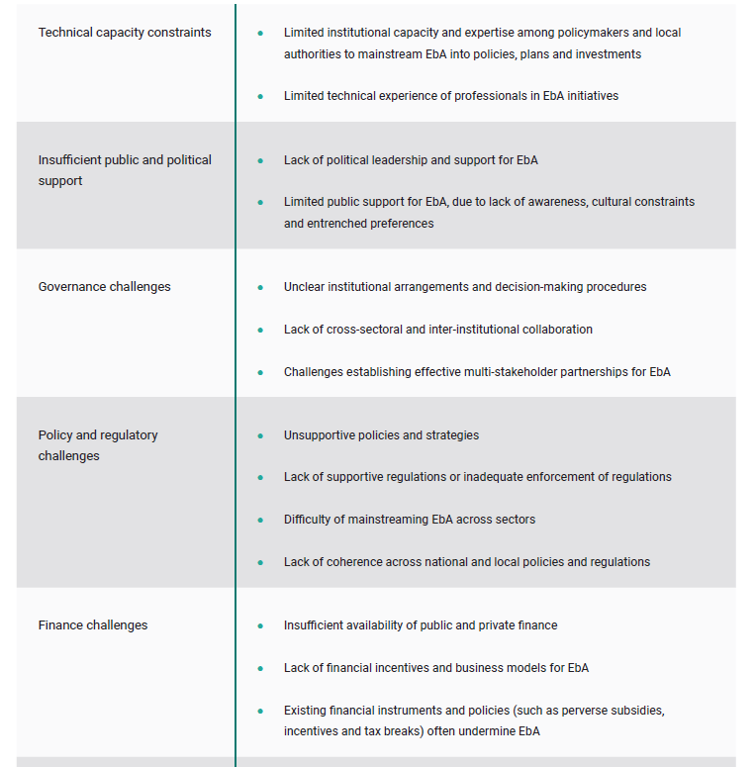
Barriers to Ecosystem based Adaptation (EbA)
What role Ministries of Finance can play?
Notes:
Source: Harnessing nature for scaling up EbA, UNEP, 2022

