Slide 1
Introducing the TNFD
Recommendations
Emily McKenzie
TNFD Technical Director
11 July 2024

Slide 2
Nature: From CSR to core risk management
The declining health and resilience of the earth's systems...
...is clearly reflected in risk perceptions.
Sources: Stockholm Resilience Centre; World Economic Forum Global Risks Report 2024.

Slide 3
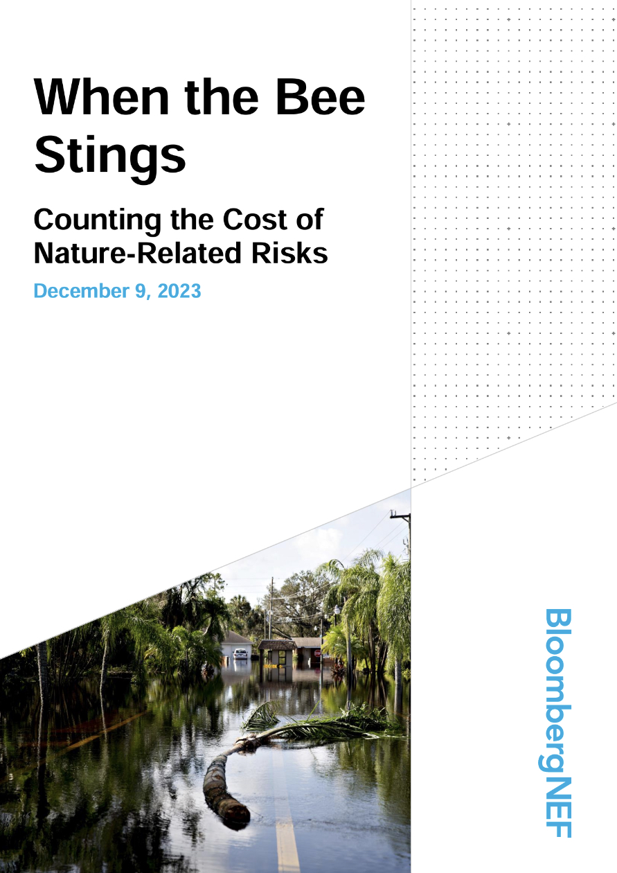
Nature risk is financial risk: Case studies & examples
“As central banks and supervisors, we have every reason to be concerned because it’s an illusion to think we can preserve financial stability if this (nature) degradation continues.”
Klaas Knot, DNB and FSB Chair
7 September 2023
10 case studies across sectors and geographies,
with US$83.2 billion in total financial impact
Quantified financial risks – market cap, credit ratings, revenues, capex
Reputation and litigation risks
CEO tenure and director liability
Bloomberg NEF, When the Bee Stings (Dec 2023)

Slide 4
Why now? Investors are seeking more information

Slide 5
What is the TNFD and why was it created?
Mission
Approach
The Taskforce
The TNFD has developed a set of disclosure recommendations and guidance that encourage and enable business and finance to assess, report and act on their nature-related dependencies, impacts, risks and opportunities.
Our aim is to support a shift in global financial flows away from nature-negative outcomes and toward nature-positive outcomes, aligned with the Global Biodiversity Framework.
Market-led:
40 Taskforce Members & 1500+ institutional supporters in the Forum
Science-based:
20 of the world’s leading scientific and standards bodies as partners
Government-supported:
G7 & G20 support
Financial Institutions
AP7, AXA, Bank of America, Banorte, BlackRock, BNP Paribas, FirstRand, HSBC, Macquarie, MS&AD insurance Group Holdings, Mirova, Norges Bank Investment Management (NBIM), Norinchukin Bank, Rabobank, Singapore Exchange, SwissRe, UBS
Corporates
AB InBev, Acciona, Anglo American, Bayer, Bunge, Dow, EcoPetrol, GSK, Grieg Seafoods, Holcim, LVMH, Natura & Co, Nestle, Reckitt, Suzano, Swire Properties, Tata Steel
Service Providers
Deloitte, EY, KPMG, Moody’s, PwC, S&P Global

Slide 6
A short history of the TNFD
June 2020: Scoping study published by Vivid Economics and Global Canopy
October 2021: Commencement of work; inclusion of TNFD in G20 Sustainable Finance Roadmap
March 2022: First beta release of draft TNFD framework
November 2022: Third beta release of draft TNFD framework
September 2023: Publication of final recommendations
September 2020: Informal Working Group begins
June 2021: Launch; G7 Finance Ministers endorse TNFD
June 2022: Second beta release of draft TNFD framework
March 2023: Fourth and final beta release of draft TNFD framework

Slide 7
Extensive market engagement and input
20
Core knowledge partners
416+
TNFD Adopters
1,500+
Forum Members
130+
Companies participating in the Data Catalyst
16
Consultation Groups
240
Pilot testing institutions
Notes:
CD

Slide 8
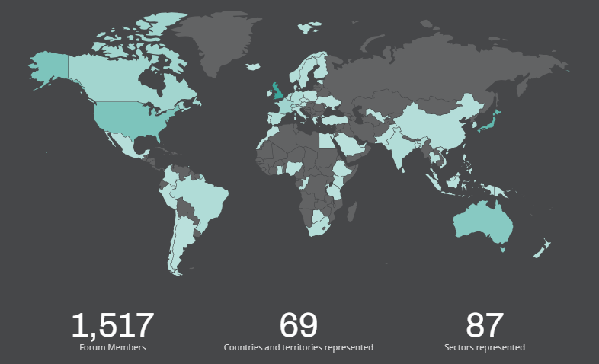
The TNFD Forum
A global multi-disciplinary consultative group aligned with TNFD’s mission and principles.
Keep up to date on TNFD’s work: Exclusive newsletter, regular webinars
Learn and build capacity: Regular webinars with expert speakers
Contribute to further development of TNFD guidance: Input via surveys, focus groups & other activities
Signal support to the ongoing work of TNFD
Free and open to a broad range of institutional types
https://tnfd.global/engage/tnfd-forum/
Notes:
CD

Slide 9
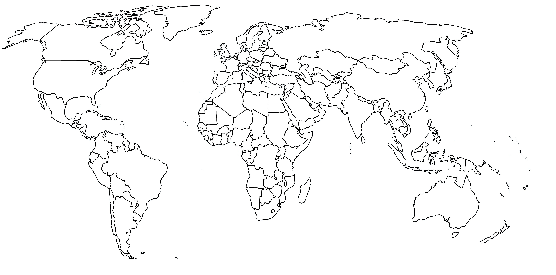
TNFD Consultation Groups: 16 across 5 continents
Key: National Multi-country Regional
Notes:
CD

Slide 10
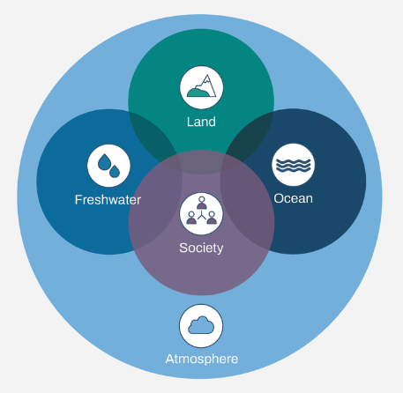
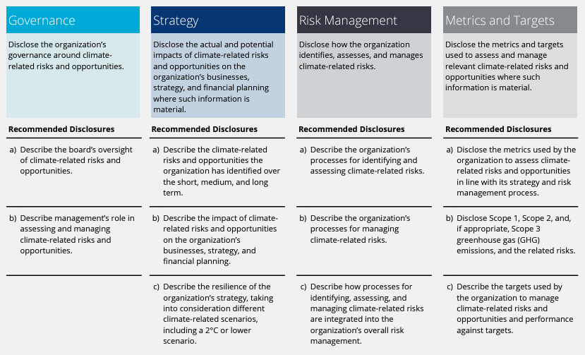
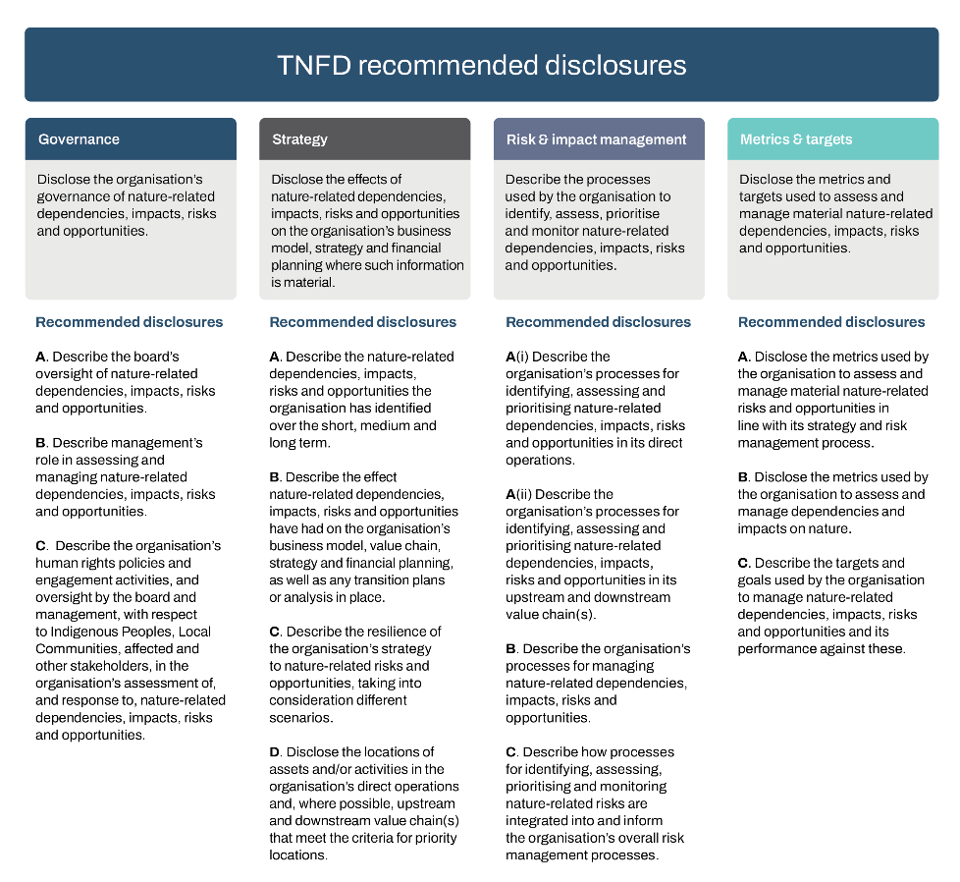
Integrated Climate/Nature Approach
Four nature realms combining nature and climate with society
Building on the TCFD recommendations to create the final TNFD Recommendations

Slide 11
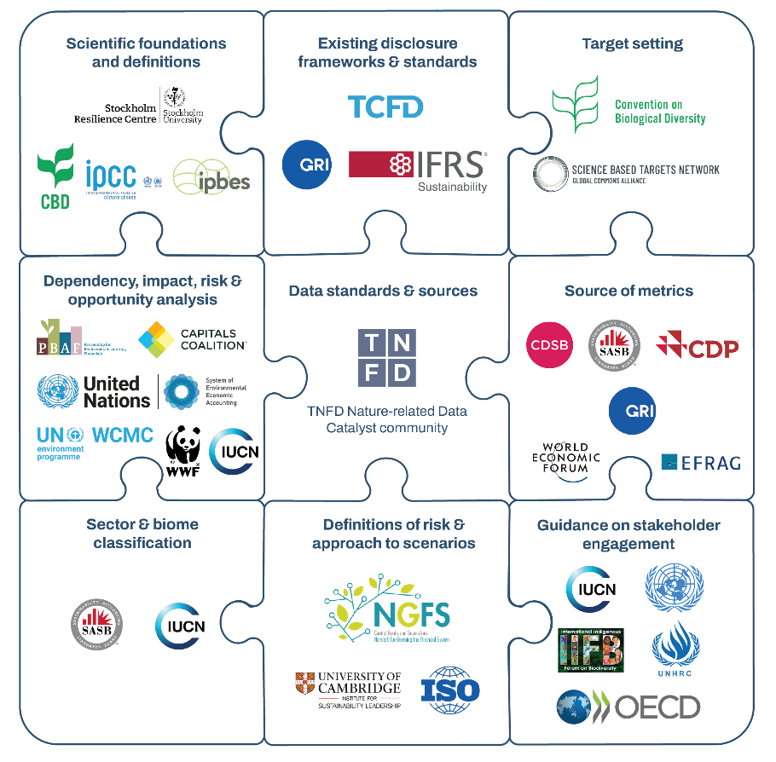
TNFD Approach – A focus on interoperability
High level of consistency with:
IFRS S1 and S2 sustainability standards (ISSB)
CSRD ESRS standards (EU)
GRI (incl. GRI 101 Biodiversity) standards

Slide 12
The TNFD Recommendations and Additional Guidance

Slide 13
14 recommended disclosures
Building on TCFD: all 11 disclosures carried over
Consistent with language and approach of IFRS S1
Aligned with GBF (Target 15) goals
3 additional recommended disclosures:
Engagement with IPLCs and affected stakeholders
Interface with priority locations
Value chains

Slide 14
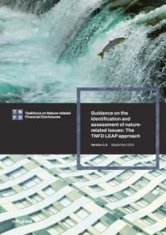
Additional guidance – the LEAP approach
Highlights​
Integrated approach developed to identify and assess nature-related issues
Designed for use by organisations of all sizes across all sectors and geographies.
Suggested guidance – not required to make TNFD disclosures​
Extensive market feedback and pilot tested by over 240 institutions across sectors, geographies and biomes​
Tips on data sources used and constraints experienced​, and links to TNFD Tools Catalogue
Notes:
AM

Slide 15
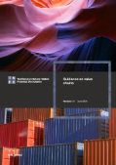
Guidance documents published on 28 June at LCAW
Final guidance & metrics
Financial institutions
Aquaculture
Biotech & pharma
Chemicals
Electric utilities & power generators
Food & agriculture
Forestry & paper
Metals & mining
Oil and gas
Final guidance on Value Chains
Draft guidance & metrics
Apparel, accessories & footwear
Beverages
Construction materials
Engineering, construction & real estate
Fisheries

Slide 16
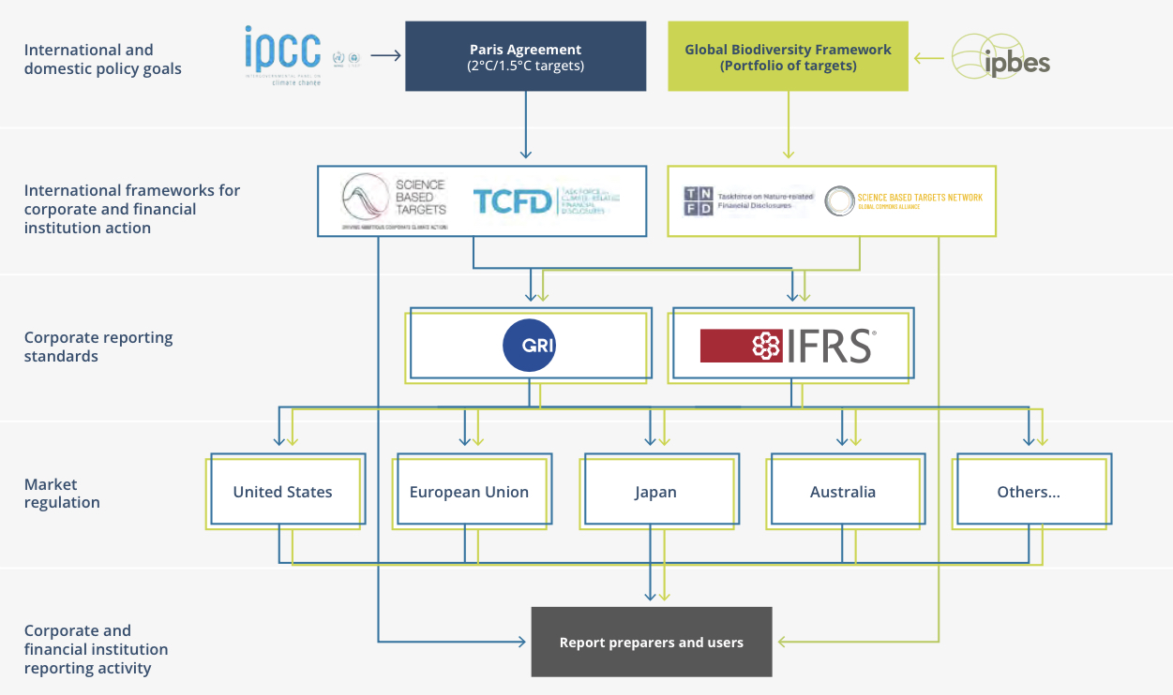
TNFD in the emerging nature reporting architecture

Slide 17
Notes:
CD

Slide 18
What’s next for TNFD
Expanded global engagement
Capacity building initiatives
Alignment with disclosure standards
Further sector guidance and sector metrics
Additional guidance on nature transition planning
Blueprint for a global nature public data facility
Notes:
CD

Slide 19
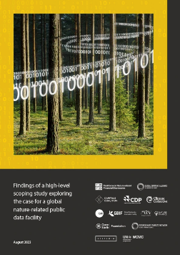
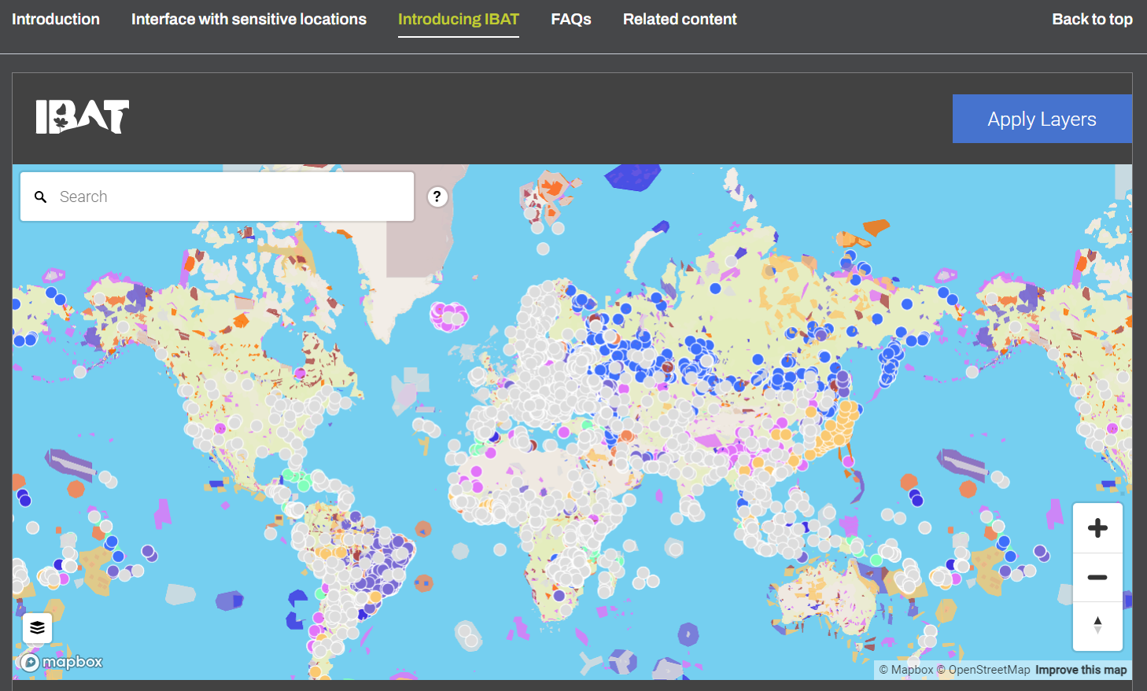
Improving quality of, and access to, data
Building awareness of existing tools and data sets
Addressing systemic data challenges – global Nature Data Public Facility
Catalyzing new data solutions –
Value Chain Data “Passport”
Request to present the Blueprint for the Nature Data Public Facility (NDPF)
to the G20 in September in Rio de Janeiro

Slide 20
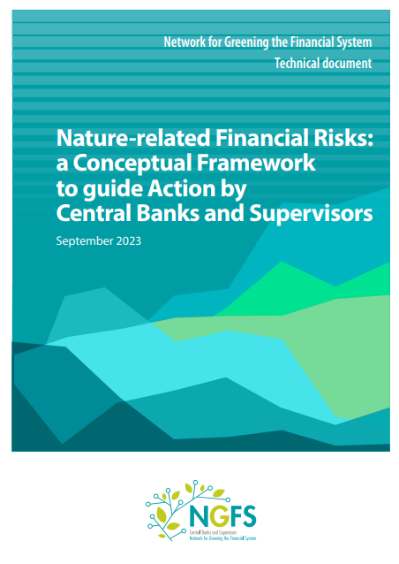
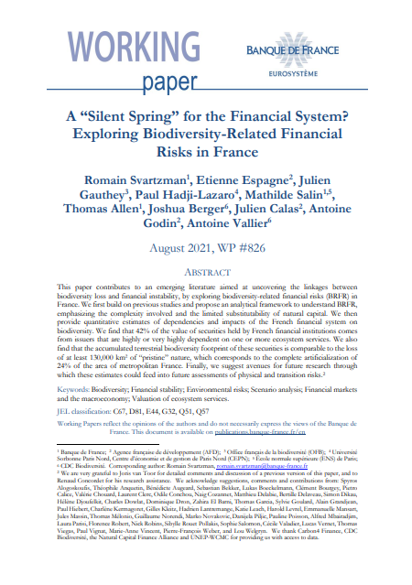
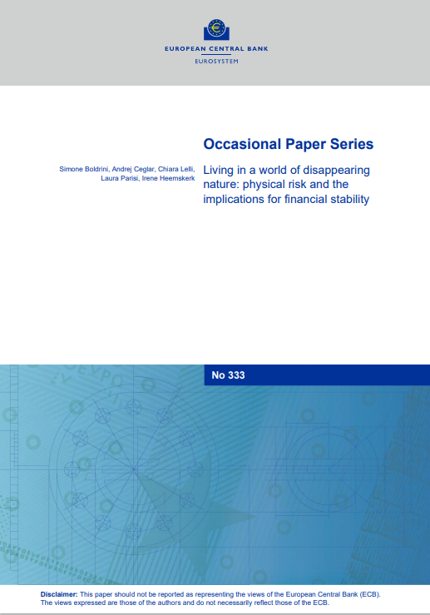
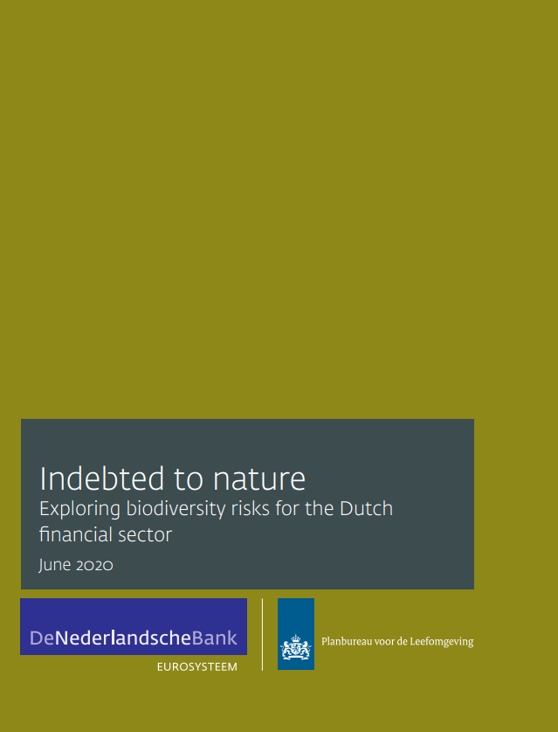
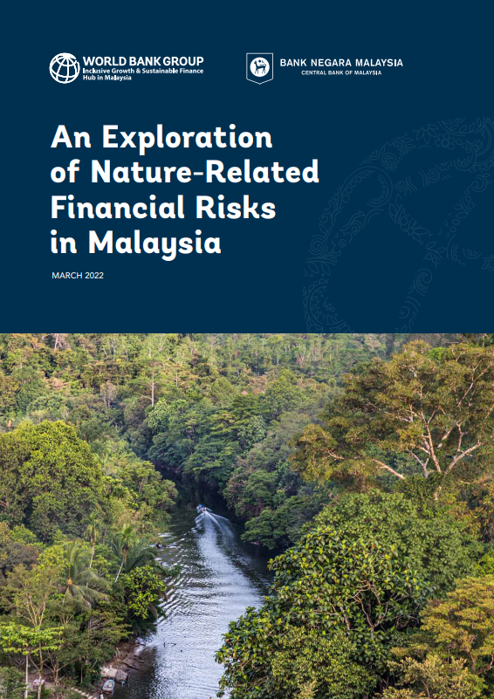
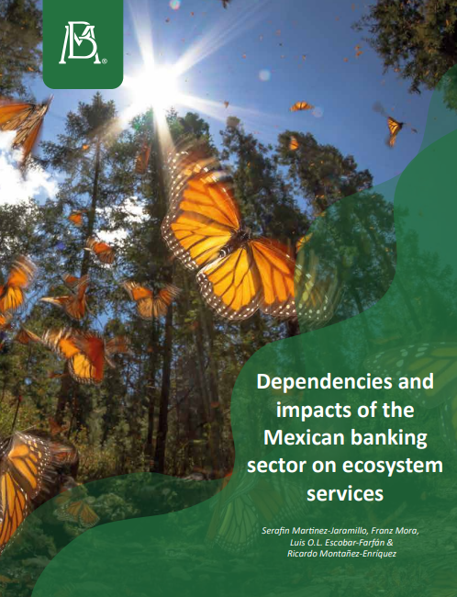
Financial regulators considering nature-related issues
NGFS: the degradation of nature can have material macroeconomic, macroprudential, and microprudential consequences
Central banks and supervisors (Euro Area, France, Netherlands, Mexico, Brazil, and Malaysia) have published macroprudential nature-related risk exposure assessments
TNFD is consulting Bank Negara Malaysia on a guide for Malaysian financial institutions, drawing on the LEAP approach.
De Nederlandsche Bank: pilot tested the beta version of the TNFD framework to assess potential risks to its own financial holdings

Slide 21
Role of Ministries of Finance
Important role in encouraging - and improving the quality and reliability of - nature-related reporting
Improve the quality and reliability of nature-related assessment and reporting
Promote transparency and standardisation
Integrate nature-related issues into financial decision-making
Support capacity building
Promote stakeholder engagement and value chain interactions
Enhance data collection and sharing

Slide 22
COP16 – Major announcements
Announce TNFD adopter update including new cohort and showcase early market experience
Release blueprint for the nature data public facility
Release discussion paper on nature transition planning (with GFANZ)
Unveil TNFD ‘white label’ training content (developed with CISL and partners)

Slide 23
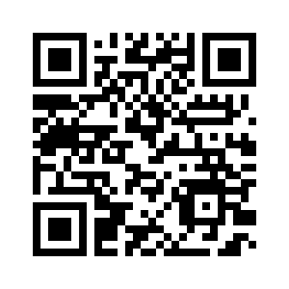
Thank you
Explore the TNFD Recommendations and guidance:

