Slide 1
Empirical evidence of the pricing of carbon emissions in Sweden using a carbon tax and emissions trading
Christian Thomann, Royal Institute of Technology, SHoF & Misum
joint work with:
Gustav Martinsson, SU, SHoF & Misum
Laszlo Sajtos, National Institute for Economic Research, SHoF & Misum
Per Strömberg, Stockholm School of Economics , SHoF, & CEPR
Joint Indonesia-Sweden-ADB-CFMCA Workshop
Jakarta, Indonesia
3 October 2023

Slide 2
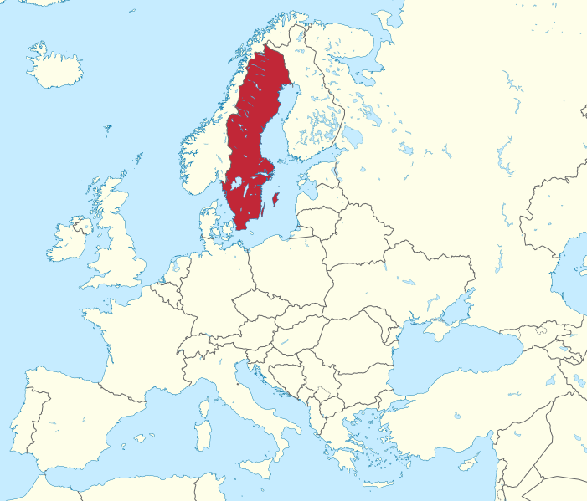
Sweden
10.5 million people
68 % landscape is covered by forests, and 9% by lakes.
Major natural resources, mainly forests, iron ore (accounted for as much as 93% of EU resources) and hydropower.
Export-oriented country, major exports are vehicles for roads, mineral oils, medical and pharmaceutical products, other non-electrical machinery paper, paperboard and articles thereof, etc..
Fraction of energy usage per sector: around 33% electricity, 16% fossil fuels, 42% biofuels.
The iron and steel sector accounts for around 14% of total energy consumption of the whole industry.
Electricity production: 41% hydro, 29% nuclear, 19% wind, 10% combined heat and power plants (in-put basically non-fossil).

Slide 3
A brief history of Swedish tax law
Major tax reform in 1991
  Inspired by US Tax Reform Act 1986
  Corporate income tax is cut from 57 % to 30 %
  Dual income tax
  VAT increased
  Carbon tax introduced
2005 carbon tax replaced by EU Emission Trading System for manufacturing and electricity production
2008 green tax shift
  Increase of carbon tax and other environmental taxes
  Cut of labor taxes and social security payments

Slide 4
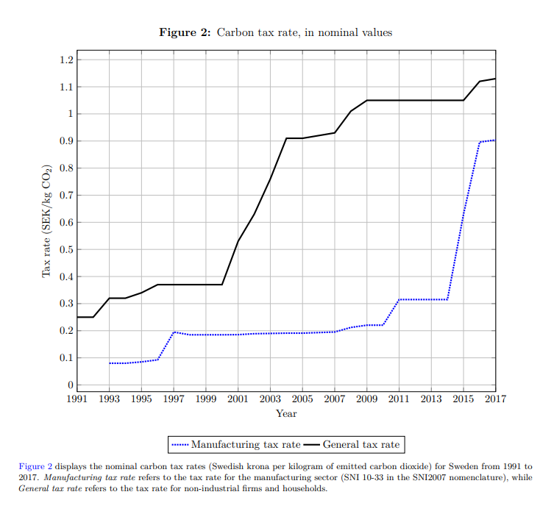
Motivation & Background
Carbon pricing is a key climate policy tool to make firms internalize the costs of their emissions
  Nordhaus (1993) ; Golosov et al. (2014); Rockström et al. (2017); Sterner et al. (2019)
  Central instrument for Sweden to reach climate goal
  Cost efficient market based approach
Existing schemes are far from ideal
  Regional, not global
    CO2 has same effect on climate regardless of where it is emitted
  Tax levels lower than “optimal” (Nordhaus, Stern, Golosov et al)
  Cover only part of CO2-emissions
  Differences in pricing across emitters due to exemptions
→ Do they have any effect on emissions?
Notes:
Sweden’s main policy instrument for reaching reduction of emissions
Cost-effective, market based instrument
Sweden has considerable experience with carbon taxation
Sweden has the world’s highest carbon tax

Slide 5
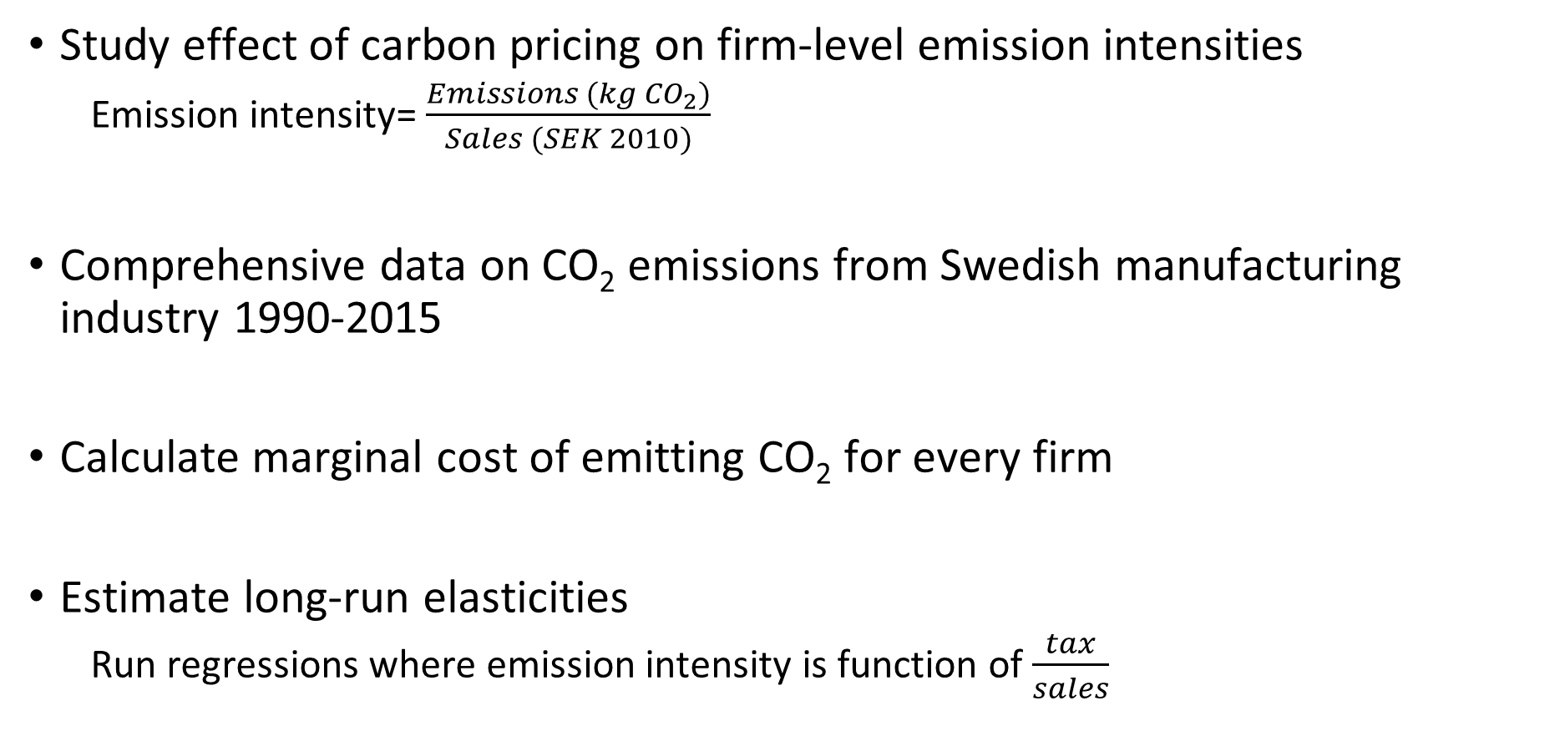
What we do in our paper
Study effect of carbon pricing on firm-level emission intensities
  Emission intensity= $\frac{Emissions (kg {CO}_{2})}{Sales (SEK 2010)}$
Comprehensive data on CO₂ emissions from Swedish manufacturing industry 1990-2015
Calculate marginal cost of emitting CO₂ for every firm
Estimate long-run elasticities
  Run regressions where emission intensity is function of $\frac{tax}{sales}$

Slide 6
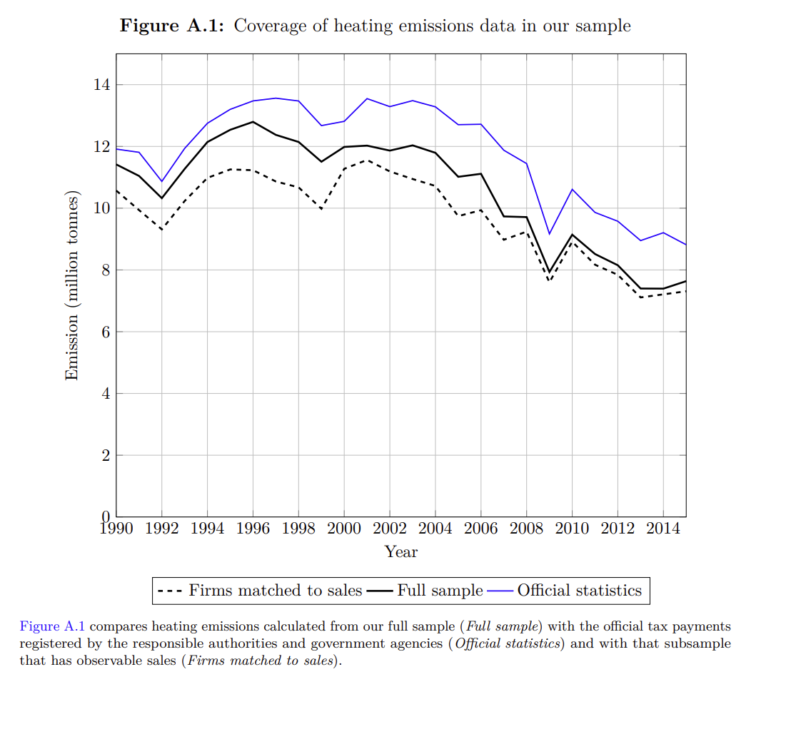
Data and sample: sources
Firm level emissions data from Swedish Environmental Protection Agency 1990-2015
Combined with
  Accounting data
  Firm-level environmental protection expenditure
  Data on tax rates and exemptions manually collected and used to infer tax payments for every firm.
  Prices are deflated using detailed industry data

Slide 7
Concentration of manufacturing CO2 emissions
Sales by 4-digit NACS emission decile
Emissions by 4-digit NACS emissions decile

Slide 8
Method and results
Estimate long term elasticities
emission intensity is function of tax/sales
Provide evidence for short-term effects (Difference in difference)
Heterogenous effect (technology, access to finance, leakage)
Calibration exercise

Slide 9

Estimating long-run tax elasticities
Regression specification (Shapiro & Walker, 2018):
  Dep variable: (log of) CO2-emissions (kg) divided by PPE-adjusted sales (SEK)
  C_{i,t-s} is marginal emission tax payments over sales (𝜏_{i,t}/Y _{i,t})
  captures the marginal change in profit margin from carbon tax payments
Identification from different marginal tax rates across firms and time:
  Firms face different marginal tax rates;
  Tax represent a different fraction of sales (tax is levied on tons of emissions)

Slide 10
Baseline estimates
It takes time to fully adjust
& technology plays role

Slide 11
Results
Do firms decrease emissions as a result of a
carbon tax?
Yes
How long does it take for firms to adjust?
Up to 3 years
How big is the effect?
(+) 1 % in CO2 tax to sales à
(-) 1.5 - 2 % emissions to sales
Are there differences between how much firms
Yes
decrease emissions?
Are differences due to technology?
Yes
Are differences due to access to finance?
Yes, (listed, age, size etc)
Is there a sizable effect of CO2 tax on emissions
Yes (~2/3 of 31 % decrease
of ind heating em)
Are results robust to EUETS?
Yes

Slide 12
Conclusion
Estimate effect of carbon tax on firm emissions over 25-year period
1% increase in marginal tax cost → 2% lower emission intensity
Simple calibration → carbon pricing can account for about up to 2/3 of reduction in aggregate emissions
Differences between firms due to technology and access to finance

Slide 13
Thank you
Christian Thomann
christian.Thomann@indek.kth.se
Link to paper:
Carbon Pricing and Firm-Level CO2 Abatement: Evidence from a Quarter of a Century-Long Panel by Gustav Martinsson, Per Strömberg, Laszlo Sajtos, Christian J. Thomann :: SSRN
Paper is accepted at Review of Financial Studies

