Slide 1
ISSB Update
Joint HP-5 Nature workshop: update on
climate-related and nature-related
disclosure requirements
Mardi McBrien
Chief of Strategic Affairs & Capacity Building, IFRS Foundation
11th July 2024
mmcbrien@ifrs.org
The views expressed in this presentation are those of the presenter, not necessarily those of the IFRS Foundation, International Accounting Standards Board or the International Sustainability Standards Board. Copyright © 2024 IFRS Foundation. All rights reserved.

Slide 2
ISSB work plan
High level of focus on supporting implementation of IFRS S1 and IFRS S2
Next, equal focus on enhancing SASB Standards and beginning new research and standard-setting projects
Some capacity reserved for flexibility to address emerging issues
Furthermore, three activities integral to all work:
interoperability with other standard- setting initiatives
connectivity with IASB
stakeholder engagement

Slide 3
Jurisdictions taking steps towards ISSB Standards
More than 20 jurisdictions have already decided to use or are taking steps to introduce ISSB Standards in their legal or regulatory frameworks.
Together, these jurisdictions account for:
~55%
40%+
50%+
of global gross domestic product (GDP)
of global market capitalisation*
of global greenhouse gas emissions
*75% excluding US market

Slide 4
Jurisdictional progress towards the adoption or other use of ISSB Standards
Americas
Asia/Oceania
EMEA
Bolivia
Brazil
Canada
Costa Rica
Australia
Bangladesh
China
Hong Kong SAR
Japan
Malaysia
Pakistan
Philippines
Singapore
South Korea
Sri Lanka
Chinese Taipei
EU
Kenya
Nigeria
Türkiye
UK
A list of ongoing and completed jurisdiction consultations on sustainability-related disclosures is available: ifrs.org/ifrs-sustainability-disclosure-standards-around-the-world/jurisdiction-consultations-on-sustainability-related-disclosures

Slide 5
ISSB Standards endorsed by international securities regulators
IOSCO endorsement sends strong signal that ISSB Standards are fit for purpose for capital market use
Creates trust in ISSB Standards for jurisdictions
IOSCO calling on 130 member jurisdictions to consider how they can incorporate ISSB Standards into respective regulatory frameworks
Historic milestone echoing IOSCO’s sole previous endorsement, which was of IFRS Accounting Standards 20+ years ago
Notes:
The International Organization of Securities Commissions (IOSCO) has endorsed the ISSB Standards following its comprehensive review of the Standards.
IOSCO’s endorsement sends a strong signal to jurisdictions around the world that the ISSB Standards are fit for purpose for capital market use, enabling pricing in of sustainability-related risks and opportunities, and to facilitate enhanced data collection and analysis.
IOSCO is calling on its 130 member jurisdictions—capital markets authorities that regulate more than 95% of the world’s securities markets—to consider how they can incorporate the ISSB Standards into their respective regulatory frameworks to deliver consistency and comparability of sustainability-related disclosures worldwide.
The announcement comes at a time when a number of jurisdictions are taking steps to introduce mandatory requirements for use of the ISSB’s first two Standards, IFRS S1 and IFRS S2.
The endorsement echoes IOSCO’s endorsement of the IFRS Accounting Standards over 20 years ago, which helped underpin widespread comprehensive adoption of IFRS Accounting Standards enabling them to become the truly global language of accounting—trusted by investors and companies worldwide and required for use by more than 140 jurisdictions.

Slide 6
Supporting IFRS S1 and IFRS S2 implementation
Develop and enhance educational materials that explain the core concepts underpinning IFRS S1 and IFRS S2.
Convene the Transition Implementation Group (TIG) to discuss companies’ questions related to implementing IFRS S1 and IFRS S2.
Monitor the progress of relevant standard-setters and framework providers to assess potential implications for IFRS S1 and IFRS S2.
Support the IFRS Foundation’s comprehensive capacity-building programme.
Support companies in using the IFRS Sustainability Disclosure Taxonomy to enhance efficient digital consumption and comparison of reports.
Notes:
CL: Now moving on to consider the specific activities that have been added to the workplan.
As discussed, most respondents considered supporting S1 and S2 implementation to be the ISSB’s highest priority. Of those respondents:
many said that supporting the implementation of IFRS S1 and IFRS S2 was essential to the successful creation of a global baseline of sustainability-related financial disclosures;
many also indicated that the effective implementation of IFRS S1 and IFRS S2 was essential to strengthening the credibility of ISSB Standards; and
a few indicated that supporting the implementation of IFRS S1 and IFRS S2 should be the ISSB’s sole focus for the next two years and stated that a Post‑implementation Review of IFRS S1 and IFRS S2 should inform the ISSB’s future research and standard-setting projects.
In line with this feedback, the ISSB agreed that supporting consistent and high-quality implementation of IFRS S1 and IFRS S2 by companies in jurisdictions around the world should be its highest priority, and so decided to assign a high level of focus to this activity.
To achieve this, the ISSB will:
develop and enhance educational materials that explain the core concepts underpinning IFRS S1 and IFRS S2;
convene the Transition Implementation Group (TIG) to discuss companies’ questions related to implementing IFRS S1 and IFRS S2;
monitor the progress of relevant standard-setters and framework providers to assess potential implications for IFRS S1 and IFRS S2;
support the IFRS Foundation’s comprehensive capacity-building programme; and
support companies in using the IFRS Sustainability Disclosure Taxonomy to enhance efficient digital consumption and comparison of reports.
CL: Richard, given that S1 and S2 were complete by the time the agenda consultation closed, why did the Board still choose to prioritise S1 and S2 over new projects?
RB:
Strongest demand in the RFI
Critical to ensure global baseline functions – don’t want to add new work on shaky foundations
CL: And how will these activities support S1 and S2 implementation?
RB:
Combination of training, tools and forums mean preparers will have much greater ability to really understand substance of the standards and see how they play out in practice.

Slide 7
Research projects
Biodiversity, ecosystems and ecosystem services
Human capital
Why?
Growing interest among investors for improved disclosure
Initial research will include considering the SASB Standards, CDSB guidance and TNFD
What could be covered?
Water
Land-use and land-use change
Pollution
Resource exploitation
Invasive non-native species
Why?
Affects companies of all sizes and types
Opportunity to address a lack of consistent, comparable disclosures
What could be covered?​
Worker wellbeing​
Diversity and inclusion​
Workforce investment​
The alternative workforce​
Labour conditions in the value chain​

Slide 8
Strategic relationships
CDP – ISSB’s climate standard is the foundational baseline for CDP’s climate disclosure
GHG Protocol – governance arrangements so that the ISSB is actively engaged in updates to the GHG Protocol Corporate Standard
GRI – full interoperability through jointly identifying and aligning common disclosures to deliver a seamless sustainability reporting system
Transition Plan Taskforce (TPT) – the IFRS Foundation will assume responsibility for TPT’s disclosure-specific materials
Taskforce on Nature-related Financial Disclosures (TNFD) – ISSB will consider how to build upon the recommendations of the TNFD to meet investors' information needs

Slide 9
IFRS S1: General Requirements for Disclosure of Sustainability-related Financial Information
Asks for disclosure of material information about sustainability-related risks and opportunities with the financial statements, to meet investor information needs
Applies TCFD architecture whenever providing information about sustainability
Requires industry-specific disclosures
For matters other than climate (IFRS S2) refers to sources to help companies identify sustainability-related risks and opportunities and information
Can be used in conjunction with any accounting requirements (GAAP)
Notes:
This slide sets out key concepts in IFRS S1, our overarching and foundational standard.
IFRS S1 sets out the overarching requirement for a company to disclose information about its sustainability-related risks and opportunities that is useful to investors in making decisions relating to providing resources to the company.
To make sure it is connected and can be considered alongside financial statements, the information is disclosed as part of a company’s general purpose financial reports.
IFRS S1 also sets out general requirements for the content and presentation of information, including the core content for a complete set of sustainability-related financial disclosures, establishing a comprehensive baseline of sustainability-related financial information to meet the needs of global capital markets.
Furthermore, the Standard:
Applies the TCFD architecture whenever providing information about sustainability, a structure already used by the many companies around the world that use the TCFD recommendations
S1 requires industry-specific disclosures so that companies can focus on reporting that better describes their business.
For matters other than climate (which is addressed in IFRS S2, the second standard published alongside IFRS S1), IFRS S1 refers to sources to help companies identify sustainability-related risks and opportunities and information, for example, the SASB Standards.
Can be used in conjunction with any accounting requirements (GAAP), while benefitting from having been designed using concepts from the IFRS Accounting Standards to help build connection with the financial statements and to deliver a holistic reporting package.

Slide 10
Nature within the IFRS S1
IFRS S1 requires companies to consider nature-related risks and opportunities and disclose material information about them.
IFRS S1 refers to:
The inextricable link between the natural environment and a company’s ability to generate cash flows over time
Natural resources – such as water - as a resource that a company might depend on and affects by its activities and outputs throughout its value chain.
If a company’s business model depends on a natural resource, then the company could both affect or be affected by the quality, availability and affordability of that resource.
Notes:
How is nature covered now in ISSB standards? -1
How/where is nature covered in S1 and S2

Slide 11
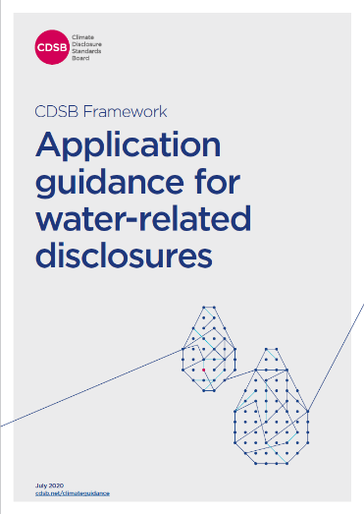
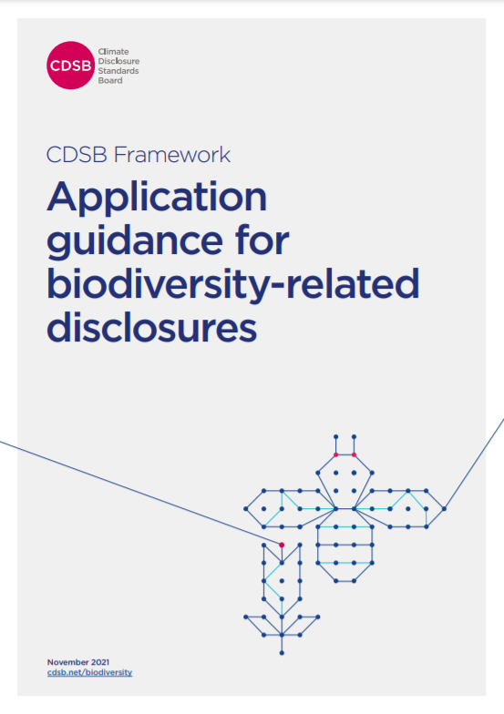
Nature within the ISSB Standards - resources
Materials covering nature-related topics are referenced as sources of guidance in IFRS S1:
industry-based SASB Standards which include nature-related industry-specific metrics
CDSB Framework Application Guidance:
Water-related Disclosures
Biodiversity-related Disclosures
Notes:
How is nature covered now in ISSB standards? -2
“nature-related” resources are referenced in S1 and S2

Slide 12
Educational material: Nature and social aspects of climate
Reminds companies consider ‘nature and social aspects’ of climate-related risks and opportunities when they prepare climate-related disclosures
‘Nature’ aspects might include those related to water or deforestation
‘Social’ aspects might include the just transition to a lower-carbon economy
Helps companies apply IFRS S2 but does not affect any of the requirements in the Standard.

Slide 13
FAQs, guides and resources curated by the IFRS Foundation and third-party organisations in support of global drive to build capacity

Slide 14
Visit ifrs.org to find out more
Access the Standards and supporting materials
Listen to the monthly podcast
Respond to live consultations
Sign up for news alerts
Learn about digital financial reporting resources
Observe ISSB meetings
Join the team

